Slide 1
Ethical Hacking-Task3
Submitted by
Devika s g

Slide 2
Report
Title: Cross-Site Scripting
Domain: Vulnweb.com
Subdomain: testasp.vulnweb.com
Steps to reproduce:
STEP 1:OPEN VMWARE WORKSTATION AND LOGIN TO KALI LINUX.
STEP 2: OPEN BURP SUITE CHECK WHETHER THE INTERCEPT IS ON .
STEP 3:OPEN FIREFOX AND SEARCH FOR VULNWEB.

Slide 3
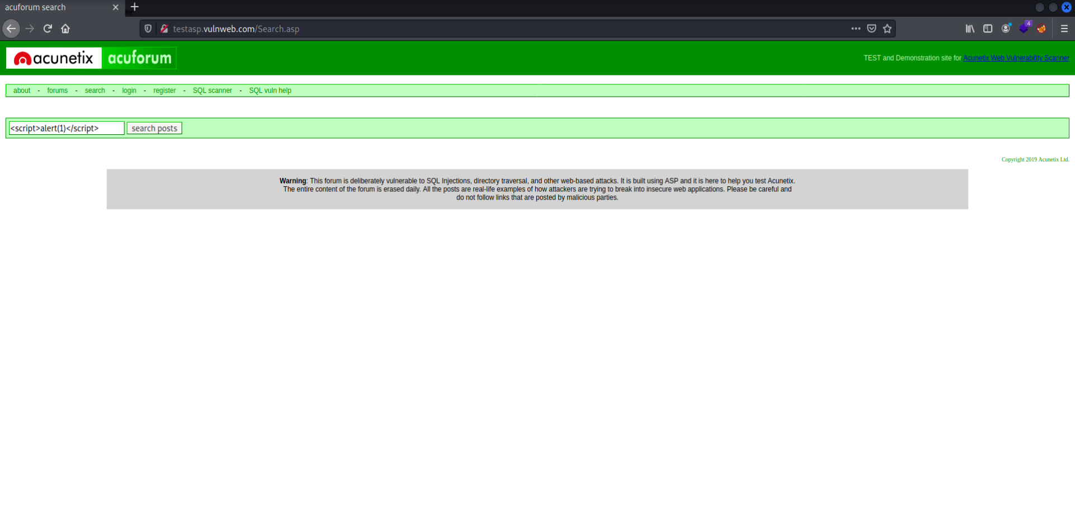
STEP 4: CLICK ON http://testasp.vulnweb.com the given interface will be opened STEP 5: CLICK ON SEARCH BAR AND CLICK THE FOXYPROXY ON

Slide 4
STEP 6: TRY TO ENTER ONE OF THE PAYLOADS SO THE REQUEST WILL BE SENT TO BURPSUITE
STEP 7: AFTER THE REQUEST COMES SEND IT TO INTRUDER AND FORWARD THE REQUEST
STEP 7:ADD THE PAYLOAD POSITION ONLY FOR THE REQUIRED PLACE.
STEP 8: ADD THE XSS PAYLOADS ,WHICH CAN BE DOWNLOADED FROM www.github.com.

Slide 5
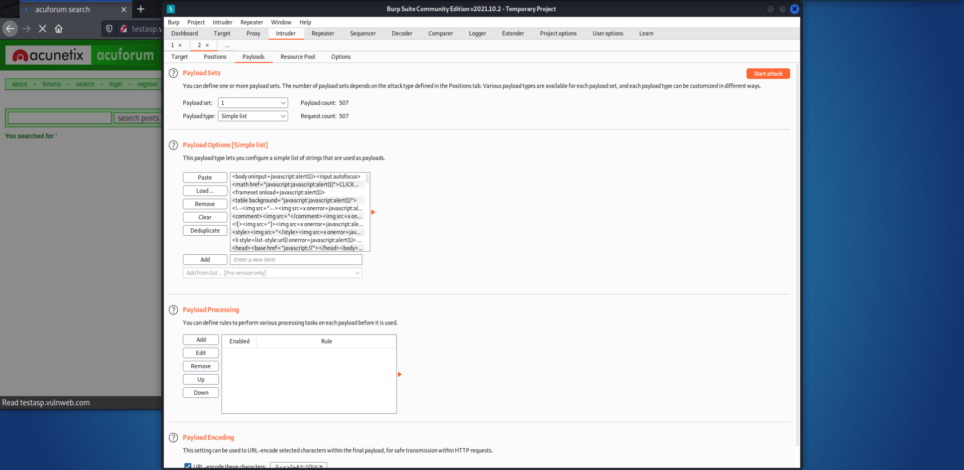
STEP 9: START THE ATTACK AND CHECK WHETHER THERE IS SUDDEN CHANGE IN LENGTH AND STATUS.

Slide 6
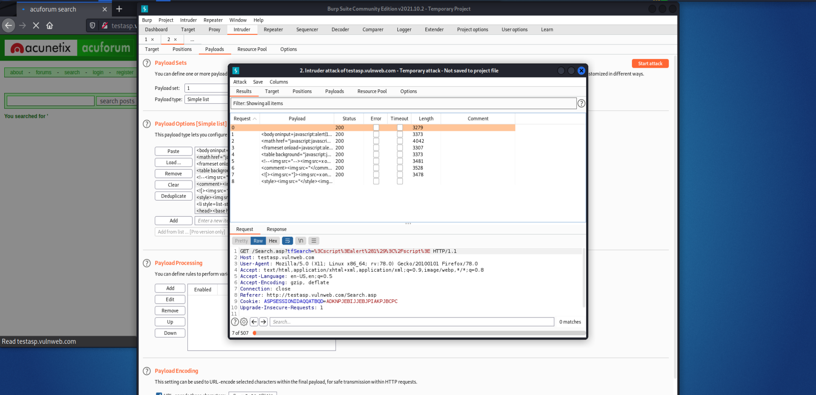

Slide 7
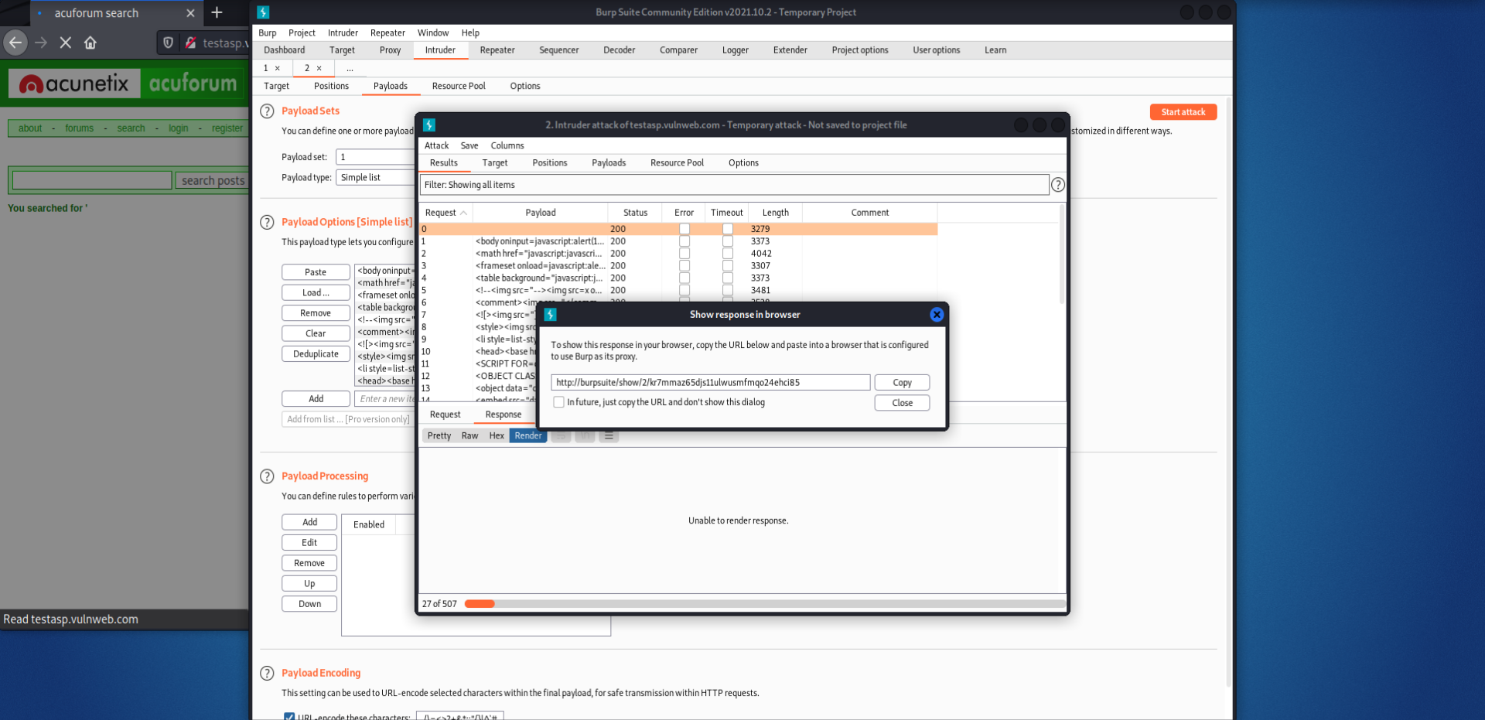
STEP 10:COPY THE URL TO SHOW THE RESPONSE FOR THE PAYLOD THAT HAS BEEN ACCEPTED

Slide 8
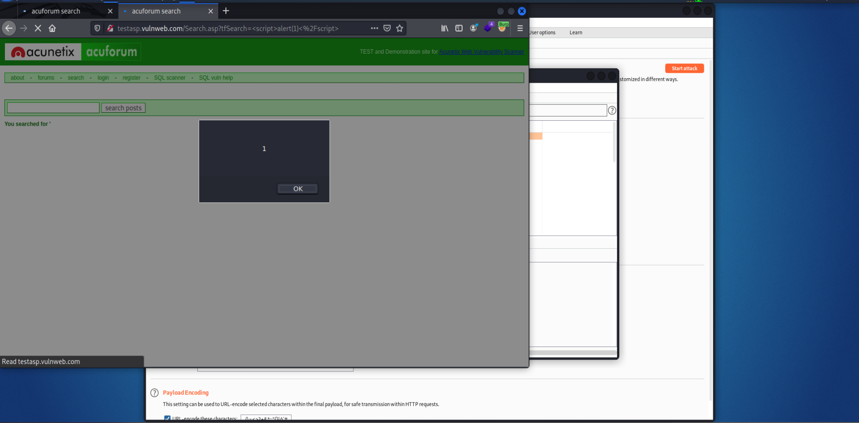
STEP 11:COPY THE URL AND SEARCH IT IN FIREFOX THE REQUIRED INTERFACE WILL BE IN THIS FORM.

Slide 9
Impact:
Cross site scripting attacks can have devastating consequences. Code injected into a vulnerable application can exfiltrate data or install malware on the user's machine. Attackers can masquerade as authorized users via session cookies, allowing them to perform any action allowed by the user account.

Slide 10
Mitigation:
1. Sanitizing Inputs:Use a security encoding library to encode all parameters and user input. If you need to insert parameters/user input data into your HTML body, add an HTML escape before insert itself.
2. Use HTTP Only cookie flag: Set the HTTP Only flag on session cookies, and any custom cookies that are not accessed by any of your JavaScript code. The flag is enabled in .NET applications default, but it needs to be enabled manually in other languages.
3. Implement Content Security Policy: Content Security Policy (CSP) is another effective strategy to help mitigate the impact of XSS vulnerabilities. It is a browser-side solution that lets you create lists specifying access permissions to client side resources, such as JavaScript and CSS.
4. X-XSS-Protection Header: The HTTP X-XSS-Protection header is a feature available in popular browsers like Google Chrome and Internet Explorer, which filters suspicious content to prevent reflected XSS attacks. If the header detects XSS, it blocks the page from loading, but doesn’t sanitize inputs in the page

